Slide 1
Faster index for property matching
Costas S. Iliopoulos, M. Sohel Rahman
Information Processing Letters, Vol 105(2008), pp. 218-223
Presenter: Hung-Hsi Chen
Date: Oct. 21, 2008

Slide 2
Abstract 1/2
In this paper, we revisit the Property Matching problem studied by Amir et al. [Property Matching and Weighted Matching, CPM 2006] and present a better indexing scheme for the problem. In particular, the data structure by Amir et al., namely PST, requires O(nlog|Σ|+nloglogn) construction time and O(mlog|Σ|+K) query time, where n and m are the length of, respectively, the text and the pattern, Σ is the alphabet and K is the output size.

Slide 3
Abstract 2/2
On the other hand, the construction time of our data structure, namely IDS_PIP, is dominated by the suffix tree construction time and hence is O(n) time for alphabets that are natural numbers from 1 to a polynomial in n and O(nlogσ) time otherwise, where σ = min(n, |Σ| ). The query time is same as that of PST. Also, IDS_PIP has the advantage that it can be built on either a suffix tree or a suffix array and additionally, it retains the capability of answering normal pattern matching queries.

Slide 4
Property
Property π of a string T[1..n] = T₁T₂…T_{n} is a set of intervals π = {(s₁, f₁), …, (s_{|π|}, f_{|π|})}, where for each 1≦i ≦| π|, it holds that s_{i}, f_{i} [1..n] and S_{i} ≦ f_{i}
Ex：
T = ATCACATCATCA
π = {(1,3), (2, 5), (6, 9), (4, 11)}
Index
1
2
3
4
5
6
7
8
9
10
11
12
T
A
T
C
A
C
A
T
C
A
T
C
A

Slide 5
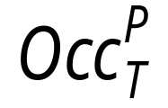
Property Indexing Problem(PIP)‏
Definition：
The pattern P[1..m] is said to occur at position i of T[1..n] <=> P = T[i..i+m-1]
We use denote the set of occurrences of P in T
Property Indexing Problem：
T[1..n] = T₁T₂…T_{n} with property π = {(s₁, f₁), …, (s_{|π|}, f_{|π|})}.
Query：pattern P = P₁…P_{m,} satisfies the set :

Slide 6
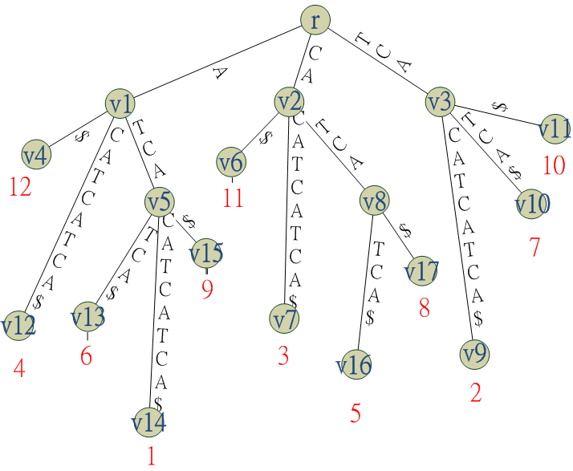
Suffix Tree 1/2
T=ATCACATCATCA
i
1
2
3
4
5
6
7
8
9
10
11
12
leaf list : LL
LL
12
4
6
1
9
11
3
5
8
2
7
10

Slide 7
Suffix Tree 2/2
Definition lv：concatenating substring from root to v
Ex：
lv₃ = TCA, |lv₃| = 3
lv₈ = CATCA, |lv₈| = 5
Definition Locus u^{p}
Pattern P as the node in ST_{T} such that l_{u}^{p} has the prefix P and | l_{u}^{p} | is the smallest of all such nodes.
Locus P does not exist, if P is not a substring of T
Ex：
P = CAT, L_{u}^{p} = CA

Slide 8
lv₃
u^{p}
lv₈

Slide 9
Construct IDS_PIP 1/5
Construct a suffix tree ST_{T} of T
Maintain leaf linked list LL
Set pointers v.left and v.right from each tree node v to its leftmost leaf v_{l} and rightmost v_{r} in the linked list.
We can indicate the of a pattern P in T by two leaves u_{l}^{p} and u_{r}^{p}.

Slide 10
Construct IDS_PIP 2/5
Node
Left
Right
Node
Left
right
R
12
10
V9
2
2
V1
12
9
V10
7
7
u^{p}
V2
11
8
V11
10
10
V3
2
10
V12
4
4
V4
12
12
V13
6
6
V5
6
9
V14
1
1
V6
11
11
V15
9
9
V7
3
3
V16
5
5
V8
5
8
V17
8
8
index
1
2
3
4
5
6
7
8
9
10
11
12
LL
12
4
6
1
9
11
3
5
8
2
7
10
P = CAT, u^{p} = V_{2,} u^{p}_{l} = 5, u^{p}_{r} = 8, LL(8) = 5, LL(9) = 8
pattern P occurs in LL from index 8 to 9
=> P occurs in {S₅, S₈}

Slide 11
Construct IDS_PIP 3/5
Constructing disjoint intervals π’
if s_{K+1} > f_{k} then the two intervals are disjoint
else s_{K+1} ≦ f_{k}
case 1: f_{k+1} ≦ f_{k}, assign e’= (s_{k}, f_{k})‏
case 2: f_{K+1} ≧ f_{k}, assign e’=(s_{k}, f_{k+1})‏
Check the next interval in π against e’
Ex： π={(1,3), (2, 5), (7,9), (8,11 )}
π’ = {(1,5), (7, 11)}
s_{k+1}
f_{k+1}
s_{k}
f_{k}
s_{k+1}
f_{k+1}
s_{k}
f_{k}

Slide 12

Construct IDS_PIP 4/5
Assume π is disjoint, we maintain array A[1..n] such that A[i] = (p, q) is a two tuple.
Where L[i] means the i-th element in LL(R)‏
Ex： π = {(1,3), (5,9), (10, 11)}
I
1
2
3
4
5
6
7
8
9
10
11
12
LL
12
4
6
1
9
11
3
5
8
2
7
10
A[i].p
-12
-4
4
3
1
1
1
5
2
2
3
2
A[i].q
-1
-1
5
3
5
2
3
5
5
3
5
2

Slide 13

Construct IDS_PIP 5/5
Preprocess the array A[i] for range maxima query(RMQ) realizing the relations.
A[i] = A[j], 1≦I,j ≦n <=> i=j
A[i] > A[j] <=> if any of the following is true

Slide 14
Preprocessing Complexity
Construct IDS_PIP
  suffix tree ST_{T} ： O(n) or O(nlog σ)‏
  Link list LL ：O(n)‏
  Disjoint interval ：O(n)‏
  Construct array A ：O(n)‏
  RMQ(A) : O(n)‏
  Total ：O(n) or O(nlog σ)‏

Slide 15
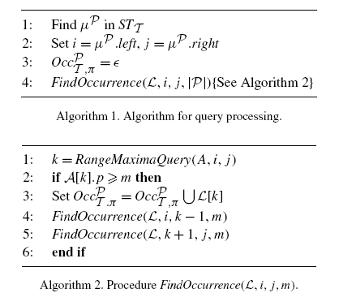
Query processing

Slide 16

Query
u^{p}
T = ATCACATCATCA，P = CAT
π = {(1,3), (5,9), (10, 11)}
= {5, 8}
u^{p} .left=LL(8)，u^{p} .right =LL(9)‏
A[8].p > 3, = {5}
I
1
2
3
4
5
6
7
8
9
10
11
12
LL
12
4
6
1
9
11
3
5
8
2
7
10
A[i].p
-12
-4
4
3
1
1
1
5
2
2
3
2
A[i].q
-1
-1
5
3
5
2
3
5
5
3
5
2

Slide 17

Query Complexity
Query：
  Find the locus u^{p} : O(mlog| Σ|)‏
  Find u^{p} .left, u^{p} .right：O(1)‏
  RMQ query：O(1)‏
  Total time doing RMQ：O(| |)‏
  Total ：O(mlog| Σ| + | |)‏

Slide 18
RMQ ：
http://www.topcoder.com/tc?module=Static&d1=tutorials&d2=lowestCommonAncestor
http://par.cse.nsysu.edu.tw/resource/paper/2006/061005/LCA_revisited.ppt

